Slide 1
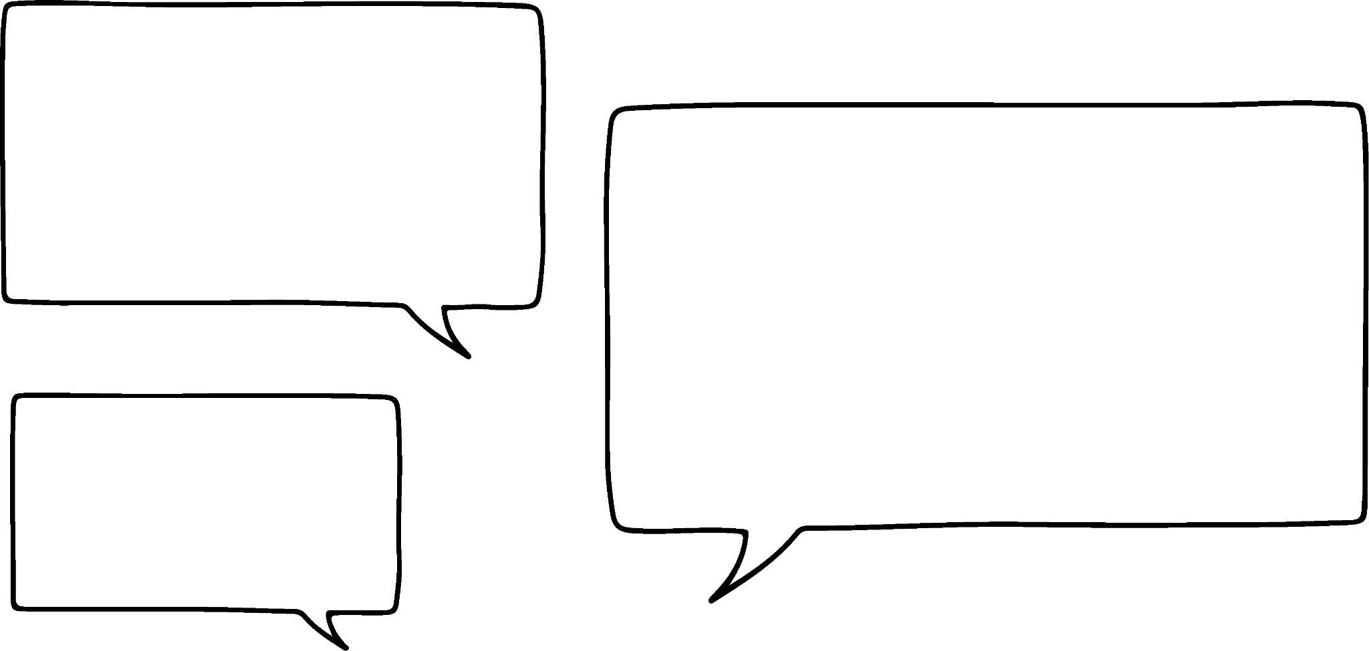




Ordering negative integers
Task A: Ordering negative integers in a context
Write the following temperatures from coldest to warmest.
(−10)℃ (−4)℃ (−8)℃ (−2)℃ (−5)℃
(−18)℃ (−22)℃ (−24)℃ (−16)℃ (−27)℃
(−32)℃ (−23)℃ (−43)℃ (−34)℃ (−48)℃
(−100)℃ (−104)℃ (−96)℃ (−88)℃ (−110)℃
(−10)℃ (−8)℃ (−5)℃ (−4)℃ (−2)℃
(−27)℃ (−24)℃ (−22)℃ (−18)℃ (−16)℃
(−48)℃ (−43)℃ (−34)℃ (−32)℃ (−23)℃
(−110)℃ (−104)℃ (−100)℃ (−96)℃ (−88)℃
2) A quiz has ten questions.
Points are given as follows: 2 points for each correct answer
(−1) for a missed question
(−3) for an incorrect answer
I scored (−9)
I scored (−3)
I scored (−5)
I scored (−10)
Lucas
Laura
Jacob
Sofia
Work out their score and rank them from lowest to highest score.
Jacob (−10), Lucas (−9), Sofia (−5) and Laura (−3)
3) A hotel has 10 floors below reception which is on the ground floor, floor 0.
There are bedrooms only on floors (−2), (−4), (−6) and (−7).
On the other floors are the following: staff room, gym, restaurant, maintenance office, basement and swimming pool.
Use the following clues to work out what is on each floor.
The swimming pool is 2 floors below the gym.
The staff room is between the basement and maintenance office.
The restaurant is higher up than the gym.
The maintenance office is 7 floors below the restaurant.
FLOOR
0 | Reception
(−1) | Restaurant
(−2) | Bedrooms
(−3) | Gym
(−4) | Bedrooms
(−5) | Pool
(−6) | Bedrooms
(−7) | Bedrooms
(−8) | Office
(−9) | Staff room
(−10) | Basement

Slide 2
Ordering negative integers
Task B: Ordering negative integers
Write the following sets of integers in ascending order.
(−6), (−9), (−5), (−8), (−3)
(−9), (−8), (−6), (−5), (−3)
(−18), (−19), (−25), (−28), (−13)
(−28), (−25), (−19), (−18), (−13)
(−89), (−91), (−88), (−99), (−19)
(−99), (−91), (−89), (−88), (−19)
(−256), (−119), (−112), (−265), (−312)
(−312), (−265), (−256), (−119), (−112)
(−6123), (−6321), (−6213), (−6231), (−6312), (−6132)
(−6321), (−6312), (−6231), (−6213), (−6132), (−6123)
2) Put the following integers into the grid.
(−7)
(−2)
(−10)
(−5)
(−15)
(−8)
(−6)
(−1)
(−20)
(−9)
(−3)
(−12)
(−18)
(−9)
(−10)
(−5)
(−8)
(−2)
(−4)
(−5)
Least
Greatest
Least
(−20) | (−15) | (−9) | (−6) | (−5)
(−18) | (−10) | (−8) | (−5) | (−4)
(−12) | (−9) | (−7) | (−3) | (−2)
(−10) | (−8) | (−5) | (−2) | (−1)
Greatest
Mathematics in Education and Industry
v2.2

